Slide 1
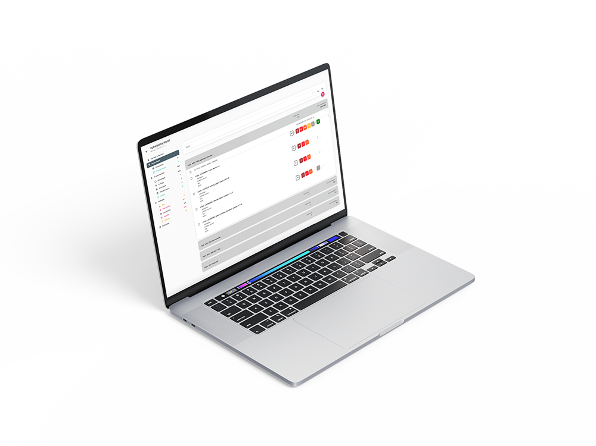

Get grip on product security with ARIANNA
HBOM & SBOM Creation | Vulnerability Monitoring & Vulnerability Management
ARIANNA is a product by

Slide 2

Why Manufacturers Struggle with CRA
CRA requires continuous vulnerability management throughout the product lifecycle.
Manufacturers must maintain SBOMs, monitor vulnerabilities, assess risk and address vulnerabilities.
Many organizations have the components but lack an operational process.

Slide 3
Why ARIANNA exists
Connected products combine hardware and software with long support lifecycles.
Manual vulnerability tracking does not scale.
ARIANNA provides HBOM + SBOM visibility, monitoring, prioritization and reporting in one platform.

Slide 4
From 2,775 Vulnerabilities to 10 Actions
A typical connected device may contain thousands of known vulnerabilities.
CVSS-only prioritization can result in hundreds of vulnerabilities requiring review.
ARIANNA prioritizes based on exploitability and context, reducing the focus to the vulnerabilities that matter most.

Slide 5
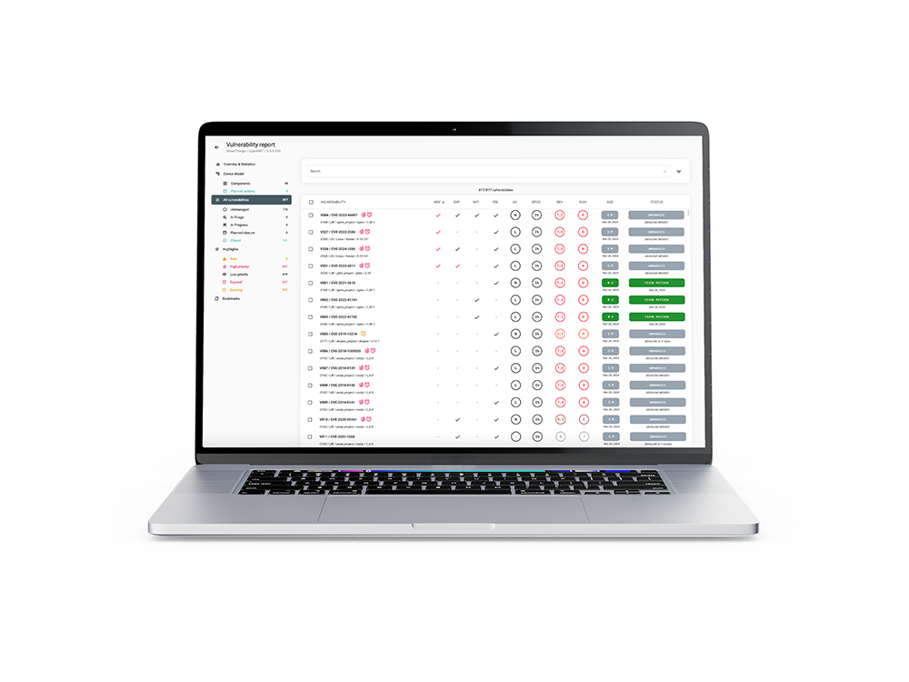
ARIANNA
ARIANNA is a platform designed to help Device Manufacturer to implement an efficient Vulnerability Management Process
Device Model Management (HBOM + SBOM)
Continuous Vulnerability Monitoring
Vulnerability Management
Reporting

Slide 6
1. Device Model creation
How to create HBOM & SBOM

Slide 7
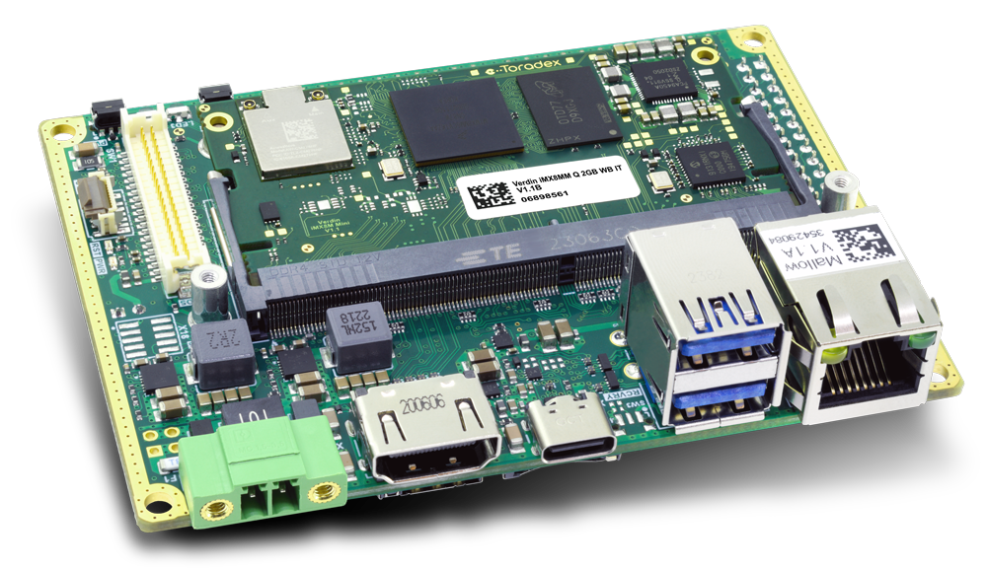
Smart Devices are not only Software
Hardware Components
MCUs | MPUs | Memories
WiFi, BLE, Radio modules | Secure Elements | TPM
VMP is incomplete without the Hardware Model
HW Components manage Critical Assets
HW Components have vulnerabilities
HW Component are not exposed in the same way to attackers
HW Model helps exclude non-reachable software vulnerabilities
WIFI MODULE
MAIN MPU
MEMORY
MCU
Notes:
In traditional IT systems we think mainly about software vulnerabilities. But smart connected devices are different. They include multiple hardware components, secure elements, and third-party modules. Some vulnerabilities exist in hardware, and many critical assets are managed directly by hardware components. So without a model that includes hardware, vulnerability management for devices is incomplete.

Slide 8
Device Model: HBOM & SBOM
ARIANNA provides support in the creation the Device Model (HBOM + SBOM)
Device Model is used to identify vulnerabilities in the target device
HBOM: List of hardware components in the target device
Built according to validated hardware part numbers, enriched with info in our internal DB
SBOM: List of software components in the target device
Built according to trusted information retrieved by ARIANNA SCA Tools
ARIANNA Software Composition Analysis Tools
Scripts (Python, Bash or PowerShell) to be executed in the development environment
SCA Tools output (CSV file) must be uploaded on ARIANNA (through Web UI or Rest APIs)
By elaborating the uploaded CSV, ARIANNA produces the final SBOM
No need to disclose source code
No reverse engineering of binaries
Unprecise SBOM: missing components, or components with wrong version
No agents installed on target devices
Invasive approach, can complicate FW / SW maintenance (agents must be updated during device lifecycle)
*SCA: Software Composition Analysis Tools

Slide 9
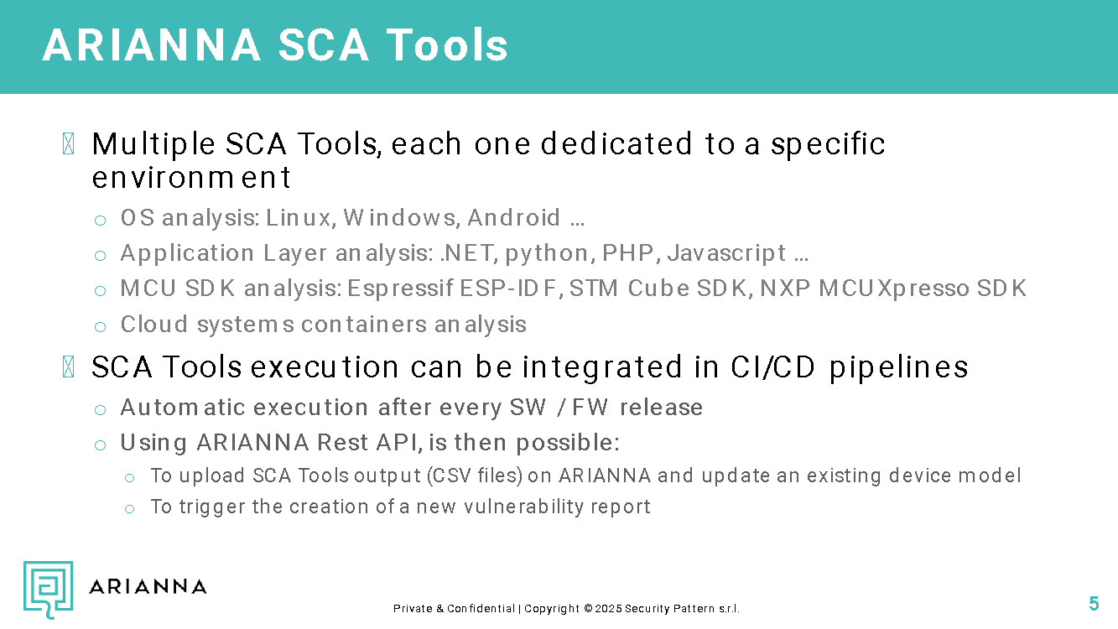
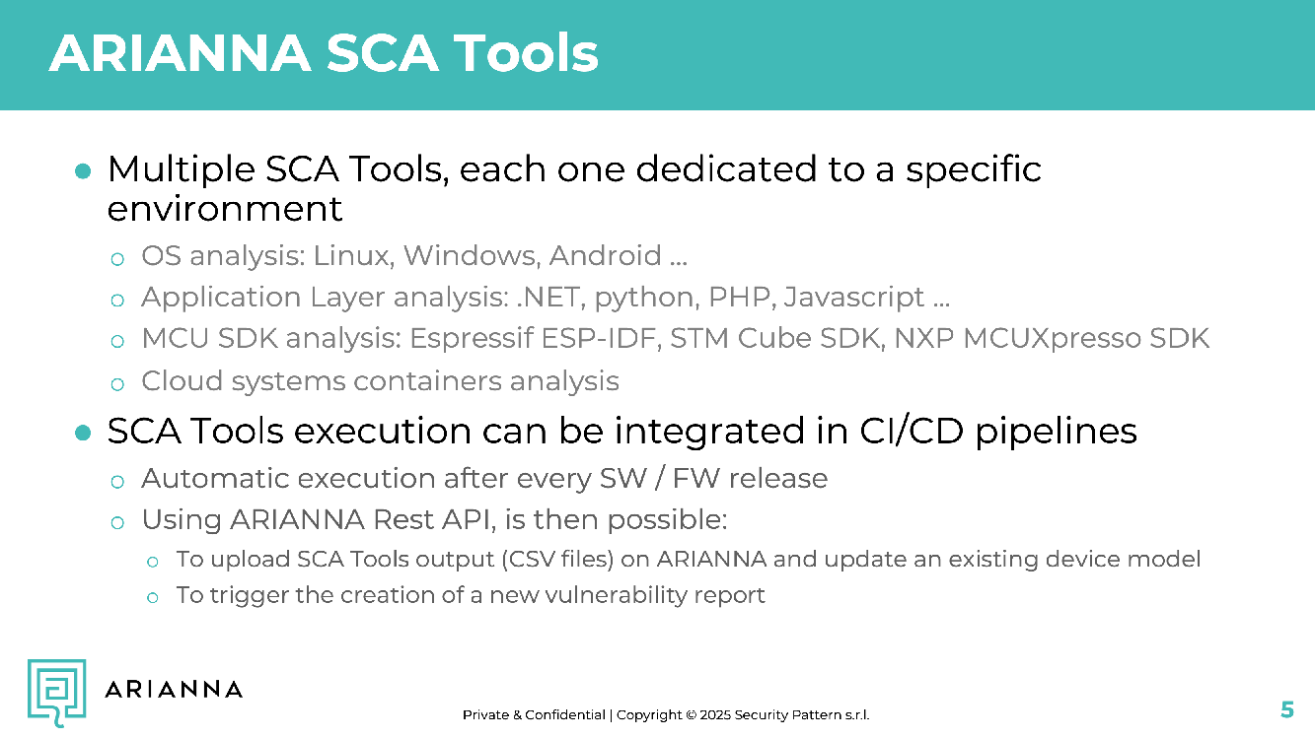
ARIANNA SCA Tools
ARIANNA provides multiple SCA tools, each targeting a specific environment.
OS analysis: Linux, Windows, Android
Application-layer analysis: .NET, Python, PHP, JavaScript
MCU SDK analysis: Espressif ESP-IDF, STM Cube SDK, NXP MCUXpresso SDK
Container and cloud workload analysis
Tools can run manually or inside CI/CD after each firmware or software release.
Outputs can be uploaded through the Web UI or REST API to update the device model and trigger a new report.

Slide 10
How SCA outputs feed ARIANNA
1. Run the appropriate ARIANNA SCA tool in the development or build environment.
2. Generate CSV evidence for the relevant OS, application, firmware, SDK, or container layers.
3. Upload the CSV outputs through the Web UI or REST API.
4. ARIANNA normalizes and merges the results into PU-specific SBOMs and the final device model.
5. The updated model immediately drives monitoring, pre-triage, vulnerability review, and reporting.

Slide 11
Device Model creation: HBOM
User must identify HW building blocks inside the device
Each hardware building block is named Processing Unit (PU)
PU examples: MCU, MPU, Secure Elements, Memories, WIFI/BLE Modules
For each PU, ARIANNA defines the HBOM according to the HW part number
PU3|ESP32
PU1 | i.MX 93
PU4 | MEMORY
PU2 | STM32F4

Slide 12
Device Model creation: SBOM
For each Processing Unit (PU), ARIANNA supports in the creation of the SBOM
PU SBOM can be the composition of multiple SBOMs
MPUs can have a SBOM for the OS + a SBOM for each customer application executed on top
MCUs can have a SBOM for the bootloader + a SBOM for the firmware
Components in the final SBOM are grouped accordingly
Each SBOM is created with the support of a dedicated ARIANNA SCA Tool
Javascript Application
SBOM
Python Application
SBOM
YOCTO SBOM
Bootloader SBOM
Firmware SBOM
Firmware SBOM
PU1 | i.MX 93
PU2 | STM32F4
PU3 | ESP32

Slide 13
Device Model lifecycle & VMP
Device Model evolves during the device lifecycle
HBOM stays constant
SBOM must be updated every time a new FW / SW is released
When a new version of the Device Model is created
New Vulnerabilities could be notified
If a new component is added
If an old component is UPDATED
Old Vulnerabilities maintain the status or could be automatically closed
If the affected component is UPDATED
If the affected component is REMOVED

Slide 14
2. Continuous Vulnerability Monitoring
How known vulnerabilities are detected

Slide 15
Continuous Vulnerability Monitoring
ARIANNA daily identifies new vulnerabilities for every monitored device, using its Device Model
ARIANNA relies on an internal database that maps hardware and software components to their associated vulnerabilities
Public Vulnerabilities Databases are daily monitored to ingest the latest vulnerability updates
NIST NVD, CVE.ORG, GitHub Security Advisories, European Vulnerability Database (EUVD)
For each known vulnerability, ARIANNA retrieves additional data to enable effective prioritization algorithms and to facilitate the risk evaluation
CISA Known Exploited Vulnerabilities (CISA KEV) | https://www.cisa.gov/known-exploited-vulnerabilities-catalog
Exploit availability & Maturity level (EXPLOIT READY / EXPLOIT POC)
EPSS index | https://www.first.org/epss/
CWE information

Slide 16
3. Vulnerability Management
How to manage identified vulnerabilities

Slide 17
Vulnerability Management Process
VULNERABILITY
IDENTIFICATION
VULNERABILITY
TRIAGE
VULNERABILITY
ADDRESSING
VULNERABILITY
(DIS)CLOSURE
1
2
3
4
ALL VULNs
FIXED | MITIGATED
NOT APPLICABLE | ACCEPTED

Slide 18
Vulnerability Management with ARIANNA
VULNERABILITY
IDENTIFICATION
VULNERABILITY
TRIAGE
VULNERABILITY
ADDRESSING
VULNERABILITY
(DIS)CLOSURE
1
2
3
4
UNMANAGED
IN TRIAGE
IN PROGRESS
CLOSED
VULNERABILITY
NOTIFICATION
DEADLINE
BASED ON POLICY

Slide 19
Severity alone is no longer enough
CVSS not sufficient for prioritization
CVSS useful to measure the potential risk
Context matters more than Severity Score
A vulnerability in a component that is not exposed to the network is very different from the same vulnerability in an internet-facing device.
Exploitability matters more than quantity
Fixing 50 theoretical vulnerabilities does not improve security as much as fixing 5 vulnerabilities that can really be exploited.
Notes:
Today most vulnerability management processes are based mainly on severity scores like CVSS. And CVSS is absolutely useful — it gives us a standard way to measure how dangerous a vulnerability could be.
The problem is that severity does not tell us how dangerous a vulnerability is for our specific device.
We are measuring vulnerabilities correctly, but we are prioritizing them incorrectly.
Smart connected devices have different risks than IT systems
Most scoring systems were created for IT environments. But smart connected devices have firmware, hardware dependencies, and very different attack surfaces.

Slide 20
Configurable Pre-Triage engine
ARIANNA provides a configurable pre-triage engine.
It splits identified vulnerabilities into two classes:
High Priority: immediate triage required
Low Priority: risk accepted for later management
The goal is to reduce analyst workload while preserving full traceability and human decision-making.

Slide 21
Pre-Triage engine configuration
Prioritize vulnerabilities based on RISK
Triage only CRITICAL and HIGH risk findings, according to the project policy
Prioritize vulnerabilities based on EXPLOITABILITY
Triage only vulnerabilities that can realistically be exploited on the target device
Examples: vulnerabilities in the ARIANNA KEV catalogue, vulnerabilities with a verified exploit, or vulnerabilities with EPSS > 10%

Slide 22
Triage workflow in ARIANNA
Pre-triage does not automatically close or accept vulnerabilities.
Low-priority vulnerabilities remain visible and traceable for later review.
High-priority vulnerabilities enter analyst triage together with exploitability, reachability, and component context.
The analyst can mark a vulnerability as Not Applicable, Accepted, Mitigated, Fixed, or escalate it for coordinated disclosure.
Every decision is logged and reflected in the report history.

Slide 23
Vulnerability Management Process
VULNERABILITY
PRE-TRIAGE
VULNERABILITY
IDENTIFICATION
VULNERABILITY
TRIAGE
VULNERABILITY
ADDRESSING
VULNERABILITY
(DIS)CLOSURE
RE-EVALUATE
1
2
3
4
ALL VULNs
HIGH PRIORITY
FIXED | MITIGATED
NOT APPLICABLE | ACCEPTED
LOW PRIORITY = ACCEPTED

Slide 24
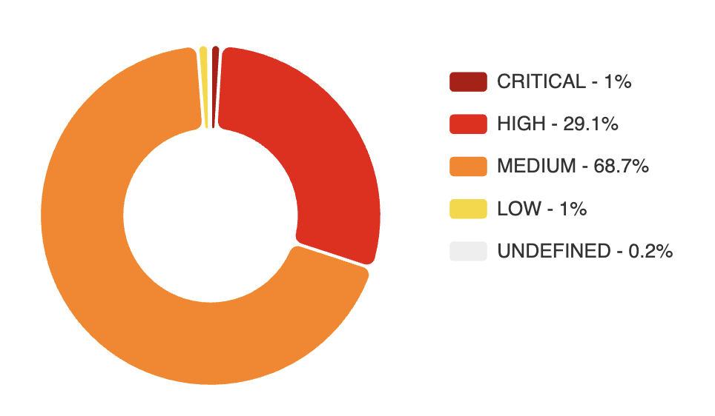
YOCTO Connected Device
2775 identified vulnerabilities
Prioritization based on Severity
CVSS Score > 7.0
27 Critical Severity (1%)
807 High Severity (29.1%)
834 vulnerabilities to be triaged ASAP

Slide 25
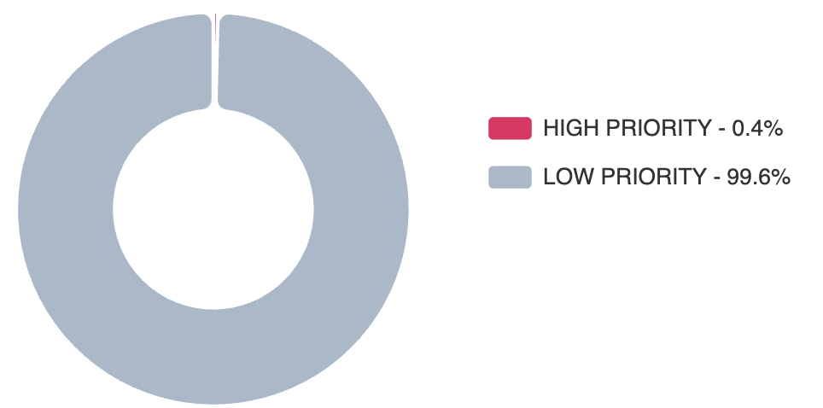
YOCTO Connected Device
2775 identified vulnerabilities
Prioritization based on Severity
CVSS Score > 7.0 (Critical & High)
834 vulnerabilities to triage ASAP (1% + 29.1%)
Prioritization based on Exploitability
Proof of Exploitation or Weaponized exploit
Attack Vector reachable by an attacker
10 vulnerabilities to triage ASAP (0.4%)
Notes:
Left side:
200 vulnerabilities panic random fixing delayed release
Right side:
Context analysis real risk identified focused remediation faster certification

Slide 26
ARIANNA KEV catalogue
ARIANNA KEV contains vulnerabilities with evidence of exploitation
Vulnerabilities contained in the CISA KEV catalogue
Vulnerabilities with proof of exploitation according to European Vulnerabilities Database (EUVD)
Vulnerabilities with a weaponized or verified exploit detected by ARIANNA
Broader and faster coverage than CISA KEV
Accelerate prioritization and remediation

Slide 27
4. Reporting
How to export HBOM, SBOM and vulnerabilities report

Slide 28
Reports for customers & regulatory bodies
SBOM (and HBOM) export
Standard formats (CycloneDX or SPDX)
NTIA Minimum Requirements satisfied
Possibility to exclude components from the exported SBOM
Vulnerability Report export
Report on-demand (PDF or VEX format)
Automatic monthly report (PDF format)
All actions taken on vulnerabilities are logged
Notification date, Closure date, Status change dates

Slide 29
5. Collaboration among teams
How to share SBOM, and information on vulnerability management

Slide 30
Projects & User Roles
ARIANNA Project
Every time a new device need to be monitored, a new Project must be created in ARIANNA
Only selected Users can access to a Project
ARIANNA Users
A User can be added to multiple projects
Same User can have different roles in each project:
OWNER: configure project policies, add/remove users, check vulnerabilities and take actions
MEMBER: check identified vulnerabilities and take actions
OBSERVER: check identified vulnerabilities and download reports, SBOM & HBOM

Slide 31


Collaboration among teams in ARIANNA
TeamA & TeamB work on 2 different projects, both monitored in ARIANNA
Each team take care of the vulnerability management of its own project
TeamC integrates ProjectA and ProjectB in a system, and open a new project in ARIANNA
TeamC would like to piggyback on vulnerability management of TeamA & TeamB for the components coming from ProjectA and ProjectB respectively
VULNs
STATUS
PROJECT A
SBOM & HBOM
TEAM A
VULNs
STATUS
PROJECT B
SBOM & HBOM
TEAM B

Slide 32


Collaboration among teams in ARIANNA
TeamC requests to be OBSERVER of ProjectA and ProjectB
As observer, TeamC can:
Access to SBOM & HBOM
Export relevant list of components and import the list of components in the newly created ProjectC
Be notified when TeamA & TeamB take actions
Check the vulnerabilities evaluation done by TeamA & TeamB in their projects, and adopt them in ProjectC
VULNs
STATUS
PROJECT A
SBOM & HBOM
VULNs
STATUS
TEAM C OBSERVER
TEAM A
SBOM & HBOM
VULNs
STATUS
PROJECT C
PROJECT B
SBOM & HBOM
SBOM & HBOM
TEAM C
TEAM C as OBSERVER
TEAM B

Slide 33
Projects & User Roles
ARIANNA Project
Every time a new device need to be monitored, a new Project must be created in ARIANNA
Only selected Users can access to a Project
ARIANNA Users
A User can be added to multiple projects
Same User can have different roles in each project:
OWNER: configure project policies, add/remove users, check vulnerabilities and take actions
MEMBER: check identified vulnerabilities and take actions
OBSERVER: check identified vulnerabilities and download reports, SBOM & HBOM

Slide 34
6. Demo

Slide 35
Demo description
Connected Device with 3 Processing Units
PU1: iMX93 MPU with YOCTO + Javascript application + Python application
PU2: STM32F4 MCU with bootloader firmware + application firmware
PU3: ESP32 MCU with application firmware
Two device model provided
1.0 - Initial model
2.0 - Updated model (new ESP32 firmware)
Prioritization based on exploitability
SUGGESTED ACTIONS
Check the report of device model 1.0
Check the report of device model 2.0 and see the differences
New vulnerabilities identified
Some old vulnerability automatically closed due to ESP32 firmware update
Check the High Priority vulnerabilities of device model 2.0
Change the configuration of the Prioritization Engine and evaluate the effects in the report
Change vulnerabilities status and evaluate the effects in the report
Export the report
PU3|ESP32
PU1 | i.MX 93
PU2 | STM32F4

Slide 36
Thank You!

